Slide 1

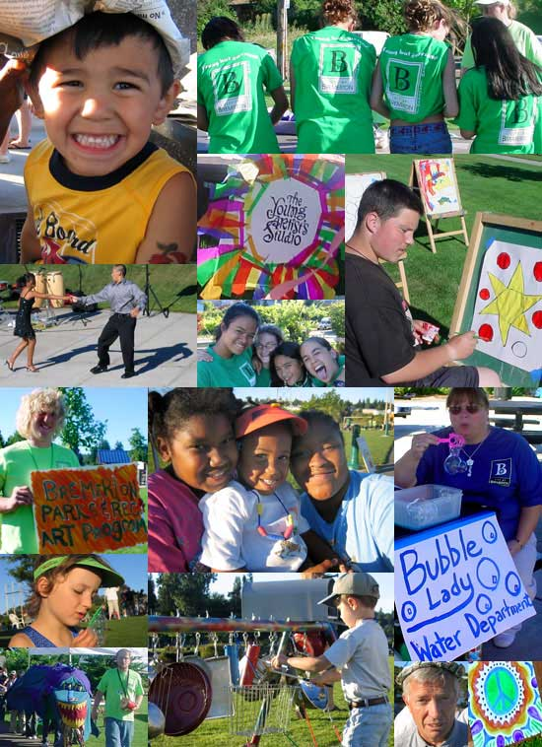
Relationships & Building a Community Focus
Relationships & Building a Community Focus
Our School Our Community (360) 473-1061

Slide 2
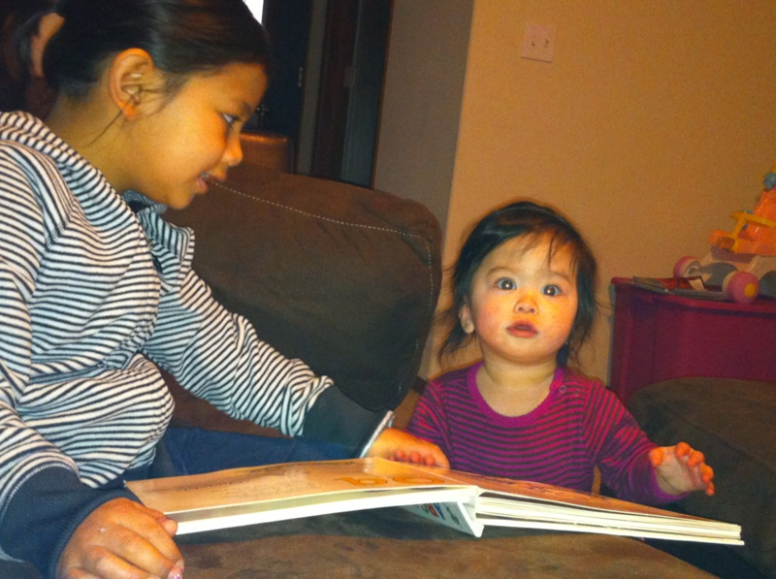
Why P-3 From A District Perspective?
The need to reach children prior to kindergarten
The need to build a strong system of support, birth to third grade and beyond
Critical period of development with
Implications for teaching and learning
Early Intervention and prevention
We can’t do it alone

Slide 3
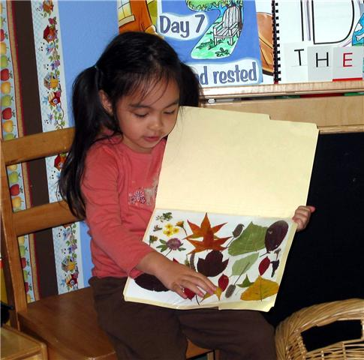
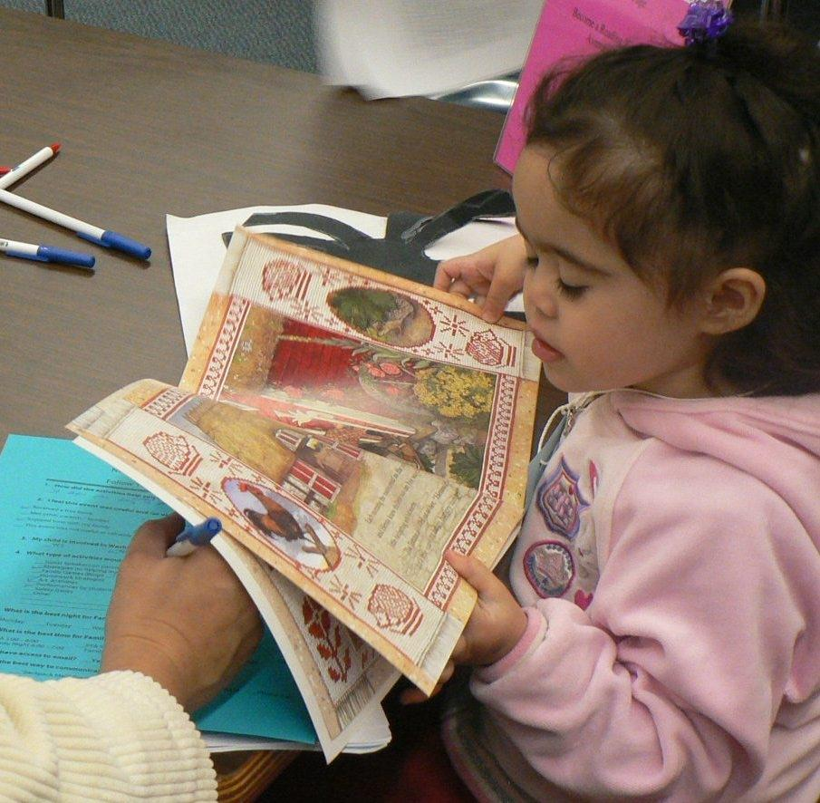
The Need
Only 4%!

Slide 4

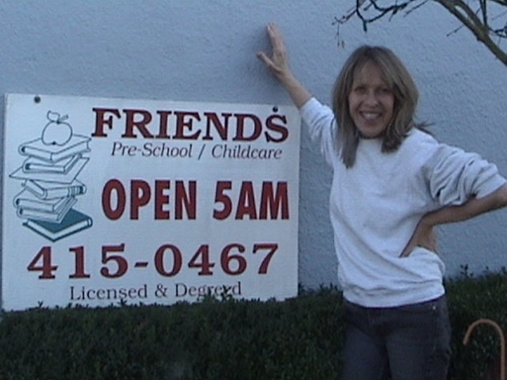
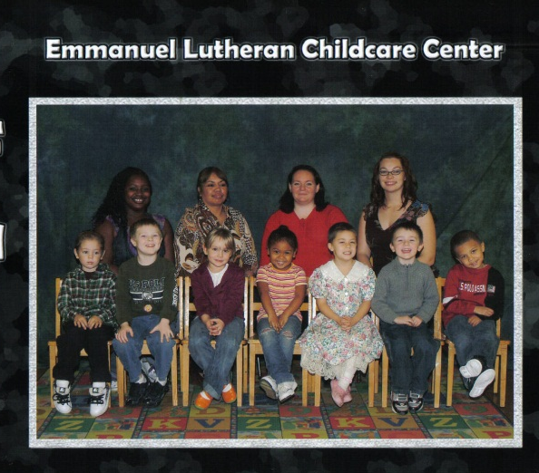
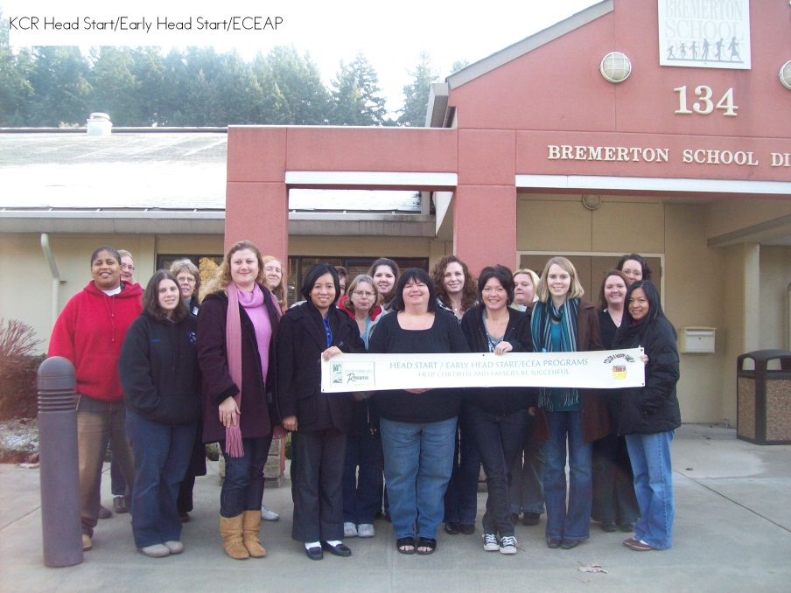

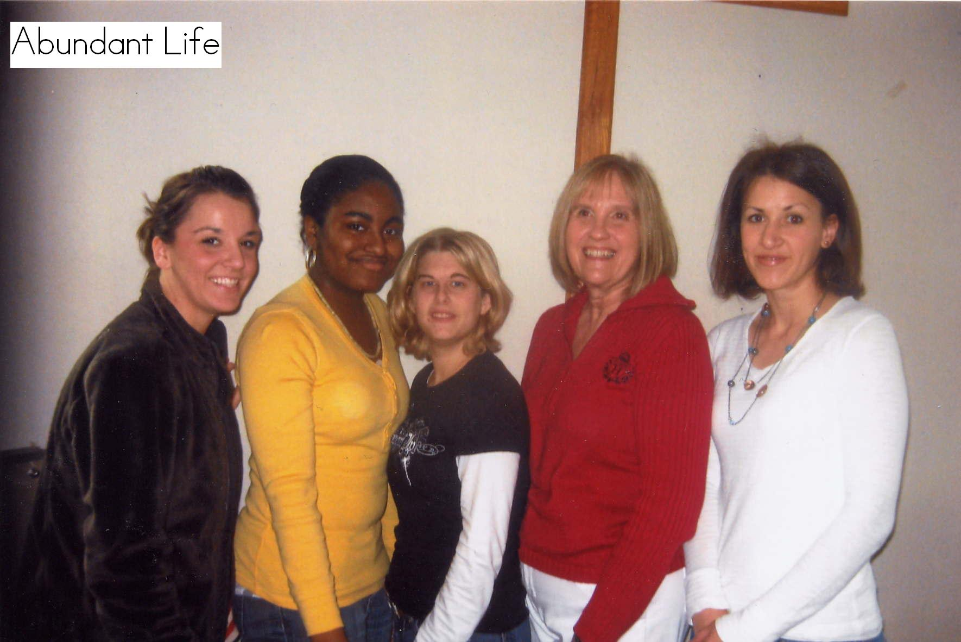
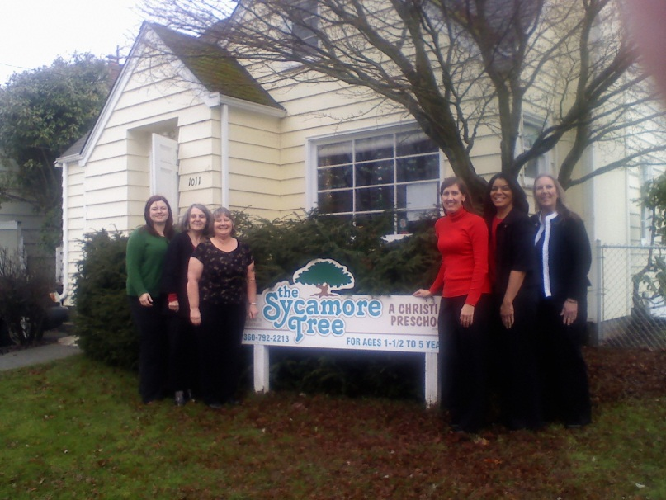
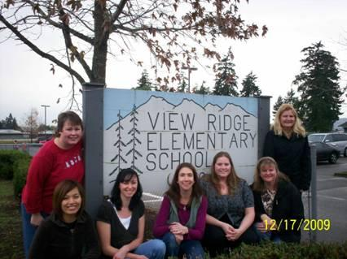
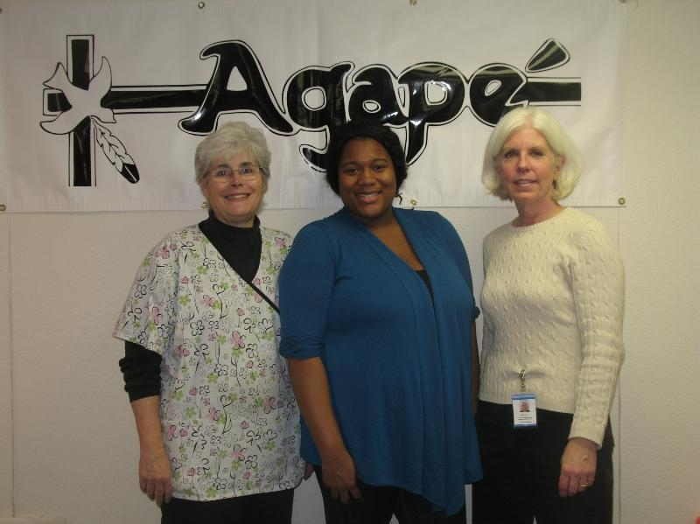
How?
Notes:
51% incoming kindergarten are from ECCE partners
17% at home
19% from other preschools
14% unknown

Slide 5


Define Quality and Make a Commitment
Early Childhood Care & Education
A
Community
Working Together
Wonders of Learning Preschool
AND
Bremerton School District
Notes:
Professional Development

Slide 6
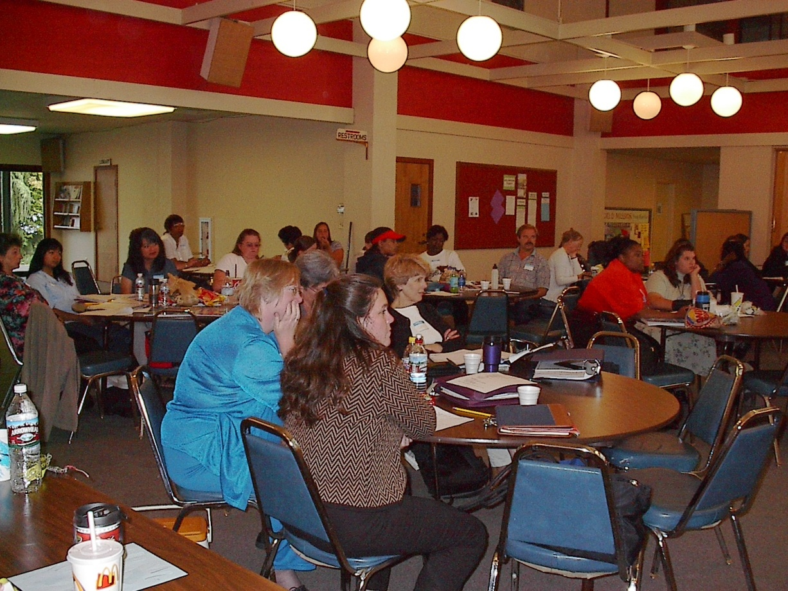
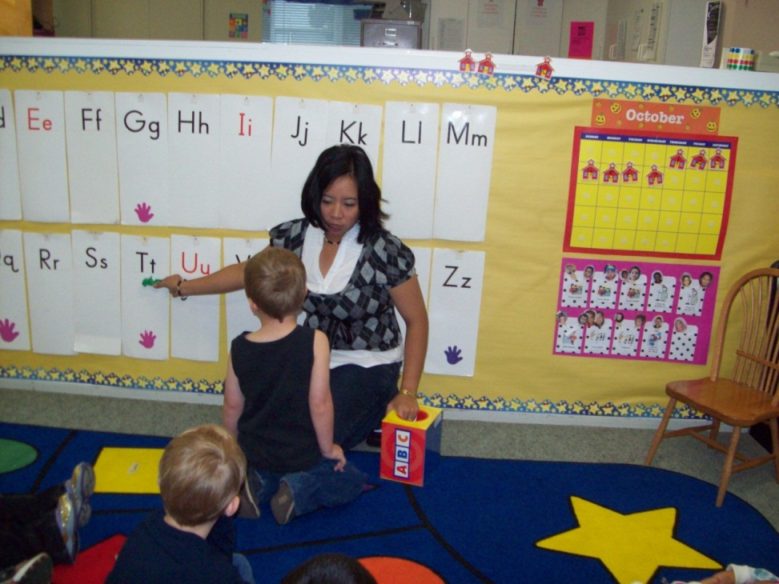
Establish a P-3 Leadership Group
Shared Leadership
Common Goals
Common Curriculum
Shared Language
Shared Resources
Assessment Loop
Aligned Instruction
and
Professional Development

Slide 7

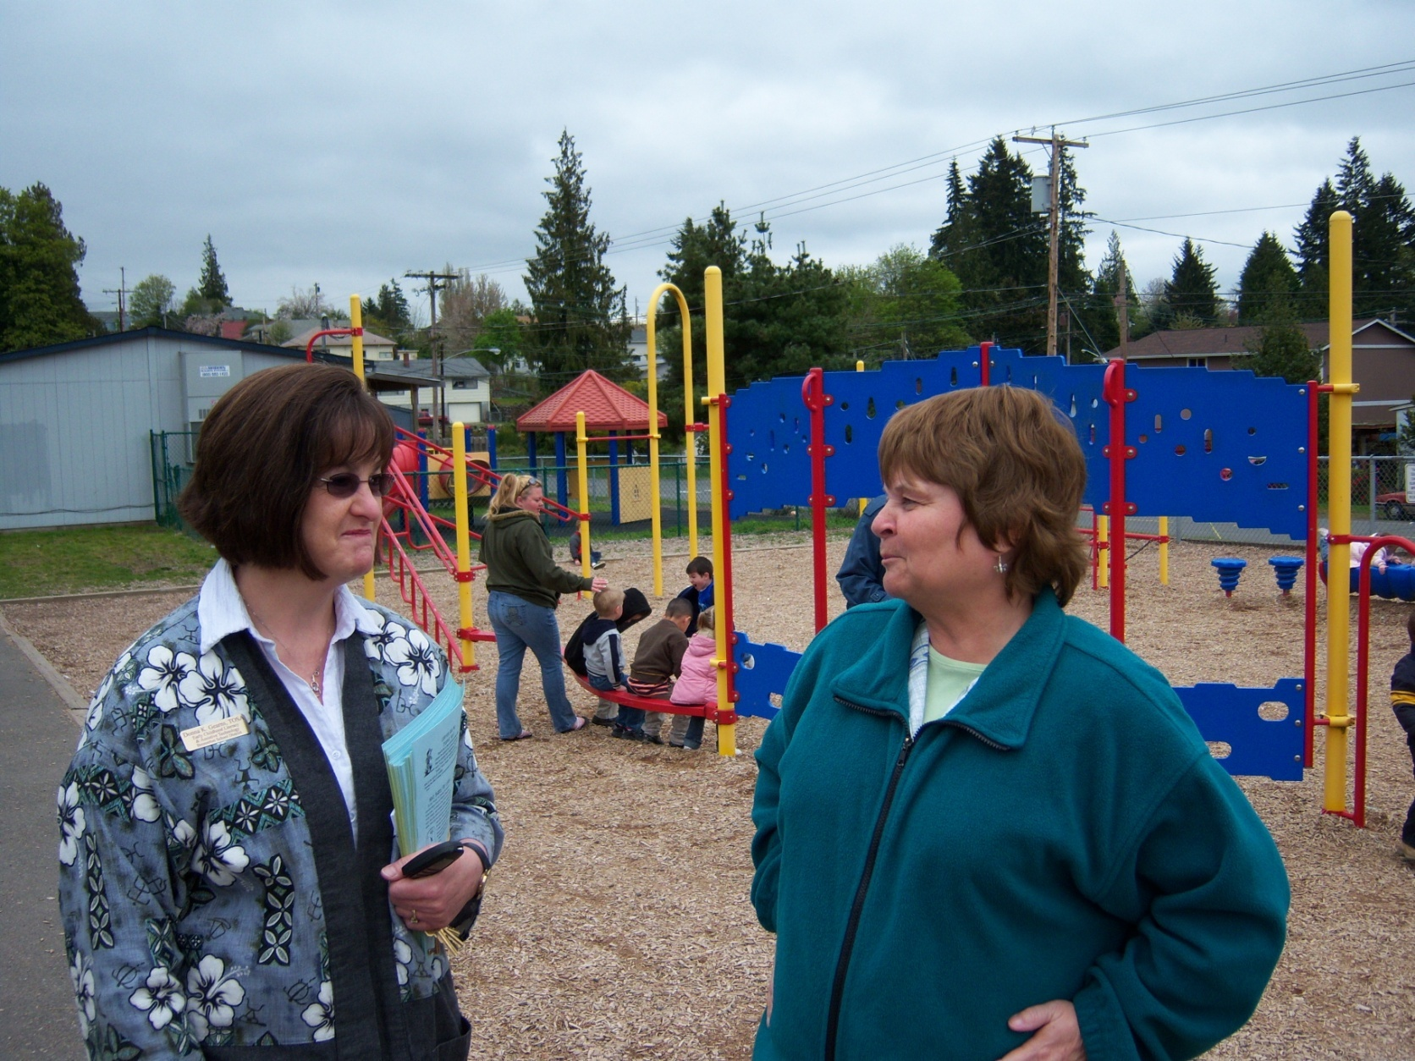
Relationships
Multiple opportunities based
on the needs
of children and staff
Notes:
School district and community working together
Invite your community preschools to a meeting
Step 4: High Quality Professional Development
HQ professional development is driven by the needs of the children and families you serve. If you set your goal of children arriving at the door with an increase in early literacy skills
What do you need to reach more children?
Putting the research into practice
Exchanging ideas that work for children
Providing materials and activities that give each community preschool the advantage.
Donna Gearns – master at this
Describe monthly professional development for teachers
Describe leadership group PD- book study
Learning Walks
PD comes in multiple forms – but focused around your goals.
When you focus – able to utilize resources – Title I, Special Ed, Head Start Title III, Title II , school improvement – all money for PD
Step 5: Connect and Align High Quality PreK to K Step 6: Maximize the Benefits of FDK

Slide 9
Kindergarten Spring DIBELS Proficiency 2002, FDK 2006-2010
May 2010 | All Day Kgt | Benchmark 91.0% | Strategic 5.3% | Intensive 3.8%
May 2009 | All Day Kgt | 94.4% | 3.6% | 1.9%
May 2008 | All Day Kgt | 93.6% | 4.4% | 2.1%
May 2007 | All Day Kgt | 92.3% | 5.9% | 1.8%
May 2005 | Extended Kgt 1/3rd of our students | 70.0% | 23.7% | 6.3%
May 2002 | Early Childhood Partnerships & half day kgt | 55.9% | 31.5% | 12.6%

Slide 10
Kindergarten Spring DIBELS Next Proficiency 2011
May 2011 | All Day Kgt | Benchmark 80.6% | Strategic 13.4% | Intensive 5.9%
Free Full Day Kindergarten for all Bremerton children

Slide 11
PreK-3 Assessment Loop, Learning Walks, and Alignment
2nd Grade Data
3rd Grade Data
1st Grade Data
2nd Grade Data
Plan and adjust instruction for incoming students
Kindergarten Data
1st Grade Data
Preschool Data
Kindergarten Data
Adjust instruction and practices to strengthen alignment for future students
Making a Difference: 10 Essential Steps To Building a PreK-3 System of Support
Linda Sullivan-Dudzic, Donna K. Gearns, Kelli Leavell

Slide 12
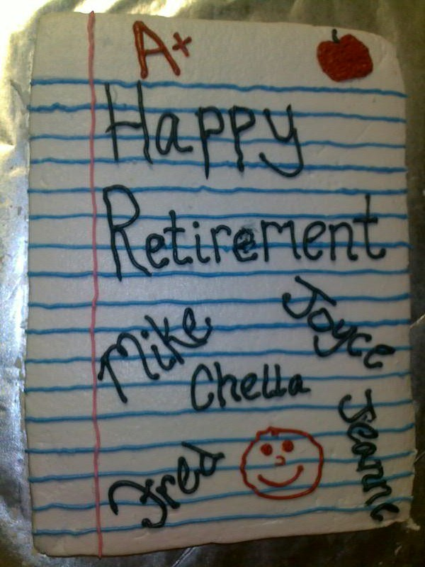
Not Every Teacher is an Early Childhood (PreK-3) Teacher
Quality counts!
“Friendly accountability “
Learning Walks

Slide 13
Aligning and Maximizing Resources
Head Start Early Head Start State ECEAP Faith-Based Nonprofit Special Ed B-3 Special Ed Preschool | Title I/LAP Title II Instructional Coach Special Education Girls and Boys Club | Transitions Professional Development Family Advocates and Interventionists Kitsap Mental Health Services | Summer Services Library Child Care Parks and Rec ESY Summer School Jump Start

Slide 14
September Benchmark DIBELS DIBELS Next Instructional Recommendation/Composite P-3 Data
Notes:
Using IR for all
Shows the gain each year, includes
Is this clear?

Slide 15
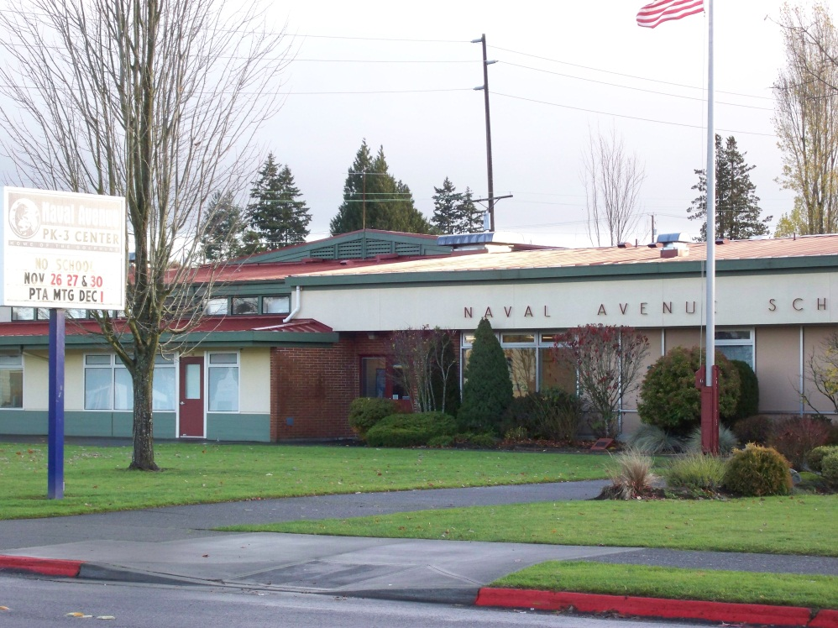
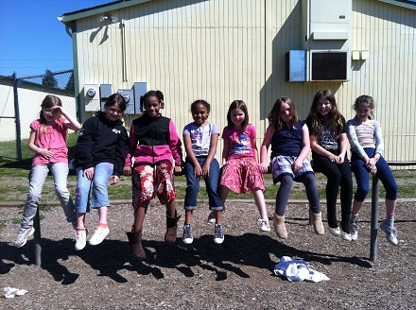
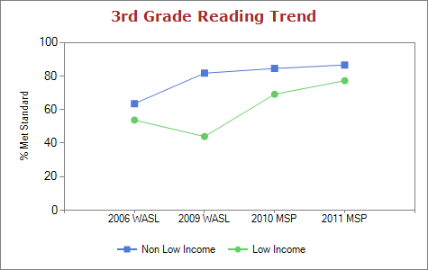
Building P-3, P-5 Schools
Naval Ave. Early Learning Center
WA State Award for Closing the Achievement Gap

Slide 16
Comprehensive District Improvement Planning: Framework & Flexibility
P-3 Standards
(CC Standards & EC Guidelines)
Assessments
Instruction & Curriculum
School response based on the students and families they serve
Classroom
Responding to the needs of students
Professional Development & Maximizing Resources
Principal & Leadership P-3 Institute Making a Difference Inc.
Linda Sullivan-Dudzic, Donna K. Gearns, Kelli Leavell

Slide 17
CSIP Planning & Instruction
Data/Assessment Growth?
How? What worked? What did not?
District/School AYP and other factors
Plan
What are the tools, materials, and PD you need to do this work?
School Level
Notes:
Data/Assessment
Growth?
How?
What worked?
What did not?
District/School AYP?
Other factors to consider?
Plan?
Tools/Materials and PD to do this work

Slide 18



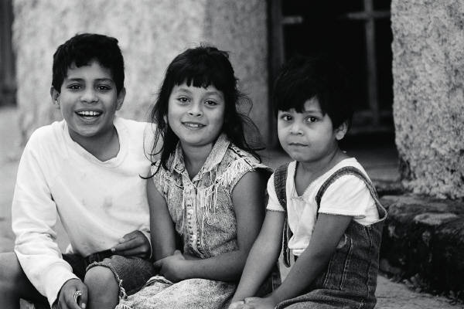






P-3 Principals & Leaders

Slide 19

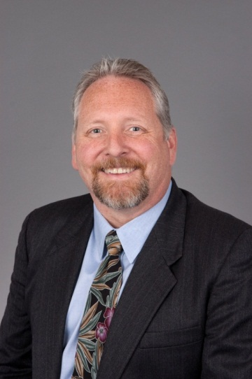
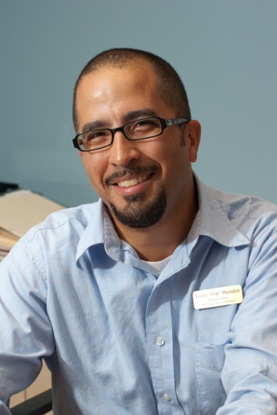
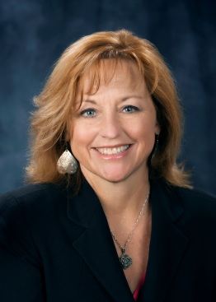
Dave Rubie
School Board Member
360.377.0340
dave.rubie@bremertonschools.org
Flip Herndon
Superintendent
360.473.1006
flip.herndon@bremertonschools.org
Questions?
Linda Sullivan-Dudzic
Special Programs Director
360.473.1061
linda.sullivan@bremertonschools.org

Slide 20

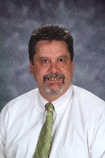
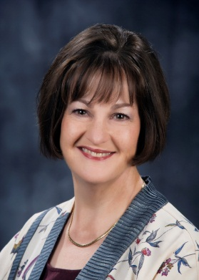
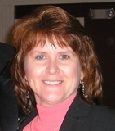
John Welsh
Principal, Naval Ave Early Learning Center
360.473.4406
john.welsh@bremertonschools.org
Kelli Leavell
ELL
360.473.1062
kelli.leavell@bremertonschools.org
Donna Gearns
Preschool TOSA
360.473.1064
donna.gearns@bremertonschools.org
Jill Brenner
Child Development Manager
Kitsap Community Resources
360.473.2097
jbrenner@kcr.org

